Slide 1
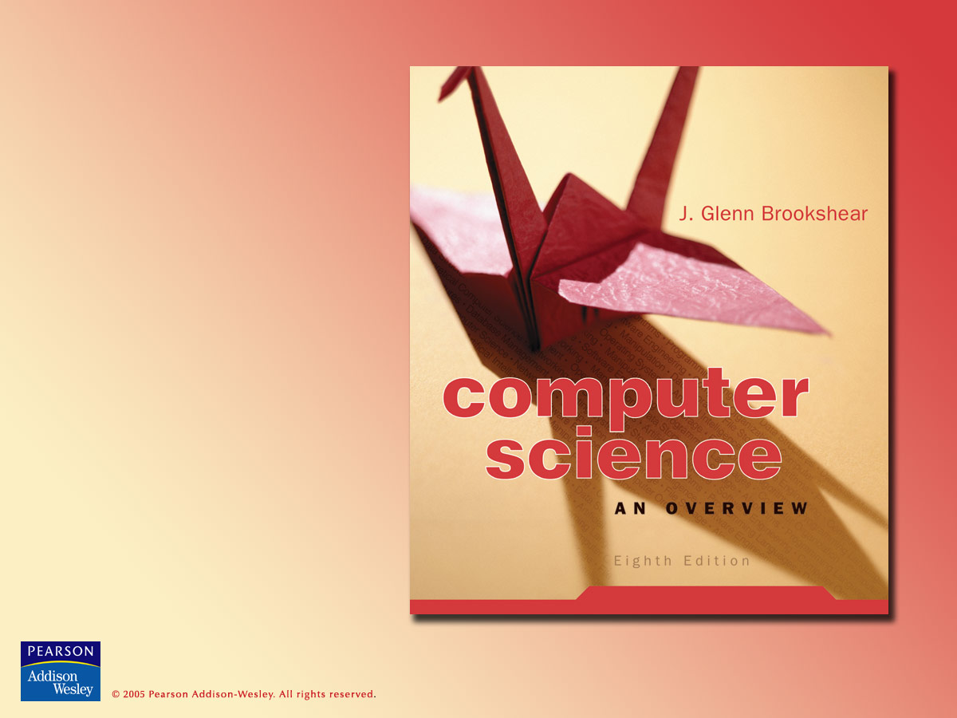
Chapter 10
Artificial Intelligence

Slide 2

Chapter 10: Artificial Intelligence
10.1 Intelligence and Machines
10.2 Understanding Images
10.3 Reasoning
10.4 Artificial Neural Networks
10.5 Genetic Algorithms
10.6 Other Areas of Research
10.7 Considering the Consequences

Slide 3
Intelligent agents
Agent = “device” that responds to stimuli from its environment
  Sensors
  Actuators
The goal of artificial intelligence is to build agents that behave intelligently

Slide 4
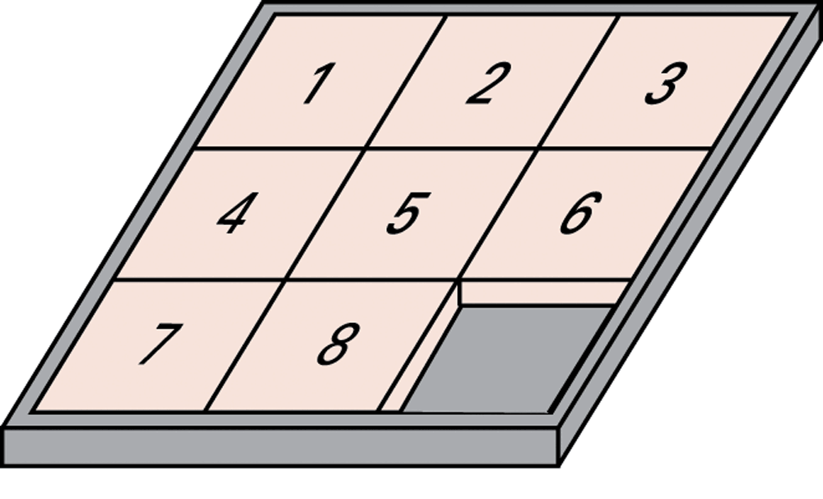
Figure 10.1 The eight-puzzle in its solved configuration

Slide 5
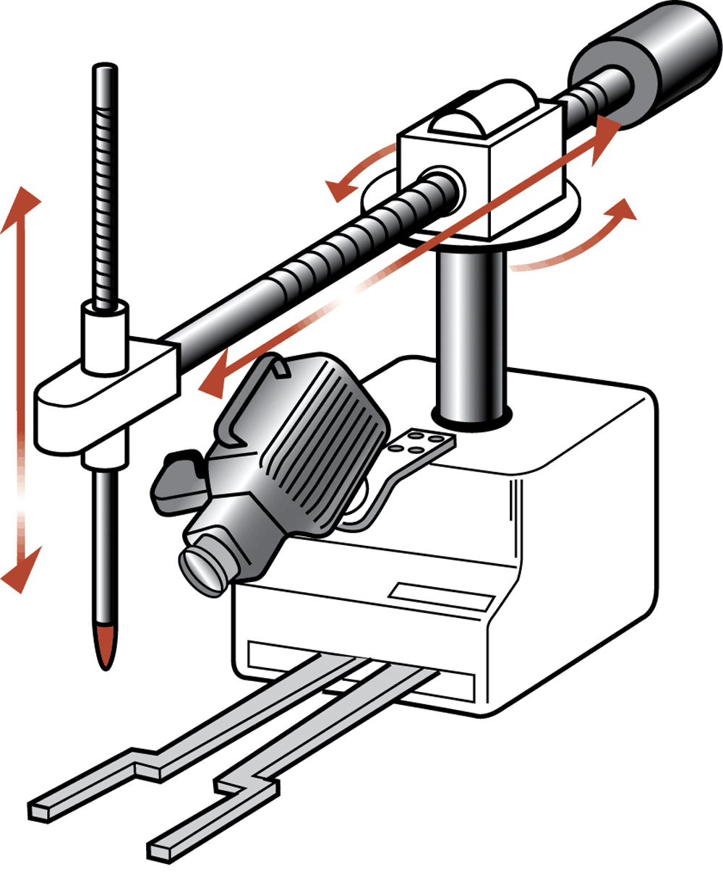
Figure 10.2 Our puzzle-solving machine

Slide 6
Levels of intelligence in behavior
Reflex: actions are predetermined responses to the input data
Intelligent response: actions affected by knowledge of the environment
Goal seeking
Learning

Slide 7
Artificial intelligence research approaches
Performance oriented: Researcher tries to maximize the performance of the agents.
Simulation oriented: Researcher tries to understand how the agents produce responses.

Slide 8
Turing test
Proposed by Alan Turing in 1950
Benchmark for progress in artificial intelligence
Test setup: Human interrogator communicates with test subject by typewriter.
Test: Can the human interrogator distinguish whether the test subject is human or machine?

Slide 9
Techniques for understanding images
Template matching
Image processing
  edge enhancement
  region finding
  smoothing
Image analysis

Slide 10
Components of production systems
1. Collection of states
  Start or initial state
  Goal state
2. Collection of productions: rules or moves
  Each production may have preconditions
3. Control system: decides which production to apply next

Slide 11
Data processing for production systems
State graph = states, productions, and preconditions
Search tree = record of state transitions explored while searching for a goal state
  Breadth-first search
  Depth-first search

Slide 12
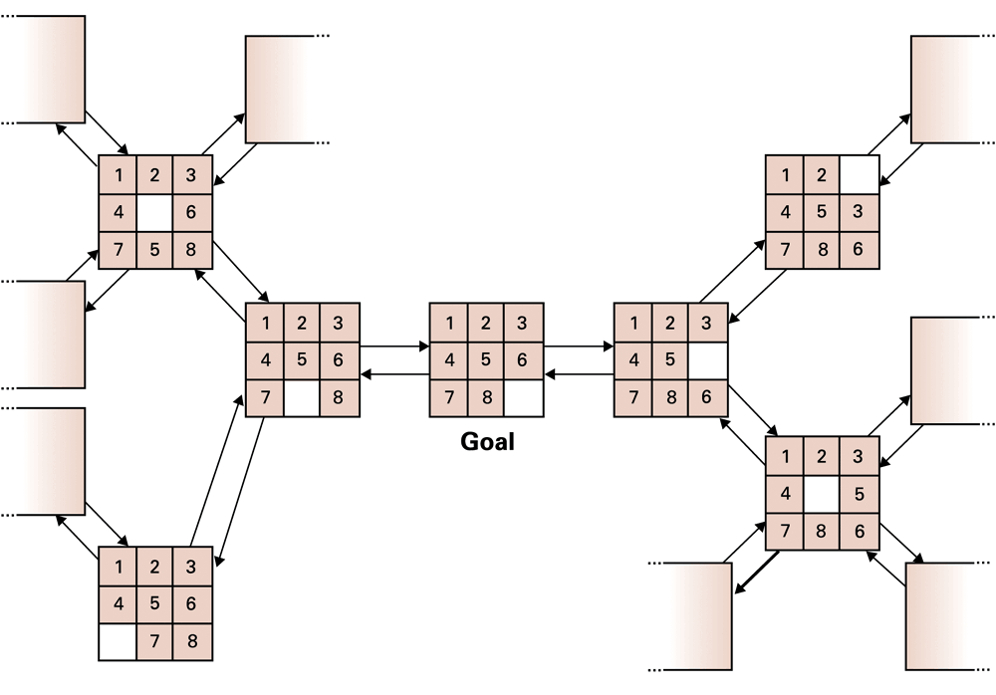
Figure 10.3 A small portion of the eight-puzzle’s state graph

Slide 13
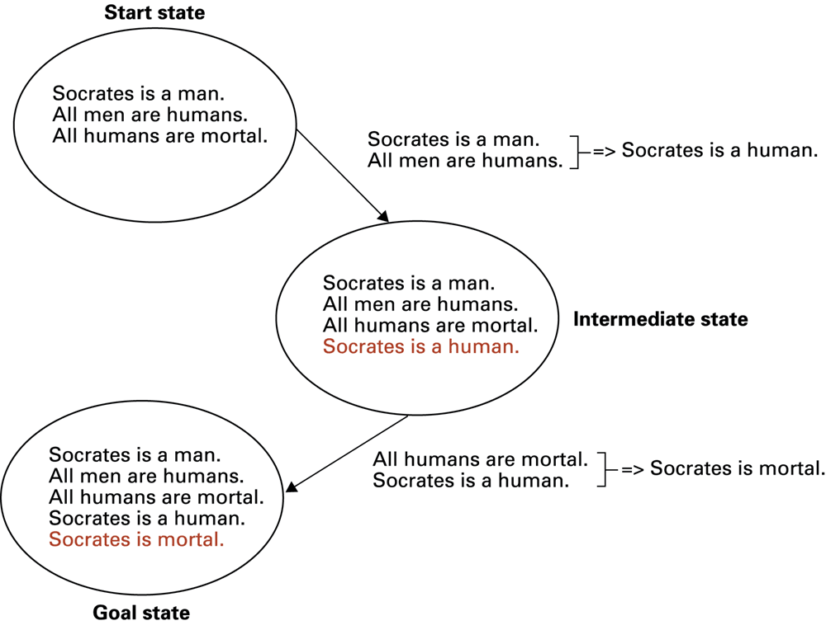
Figure 10.4 Deductive reasoning in the context of a production system

Slide 14
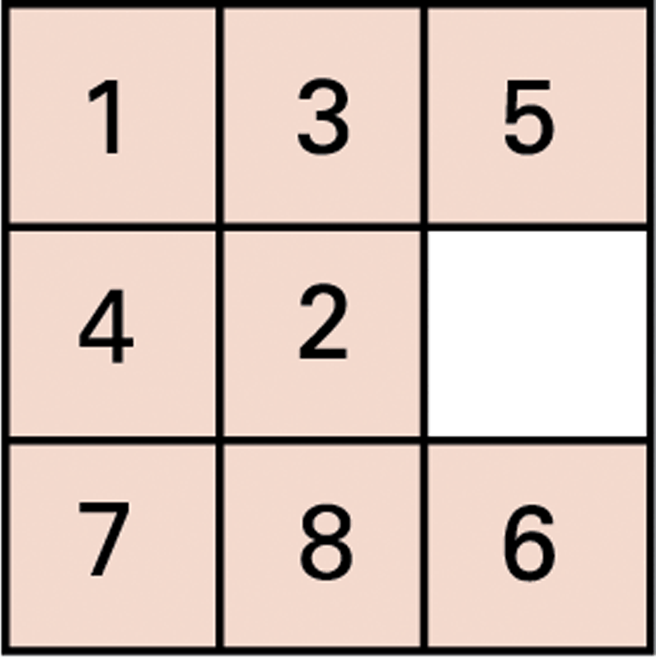
Figure 10.5 An unsolved eight-puzzle

Slide 15
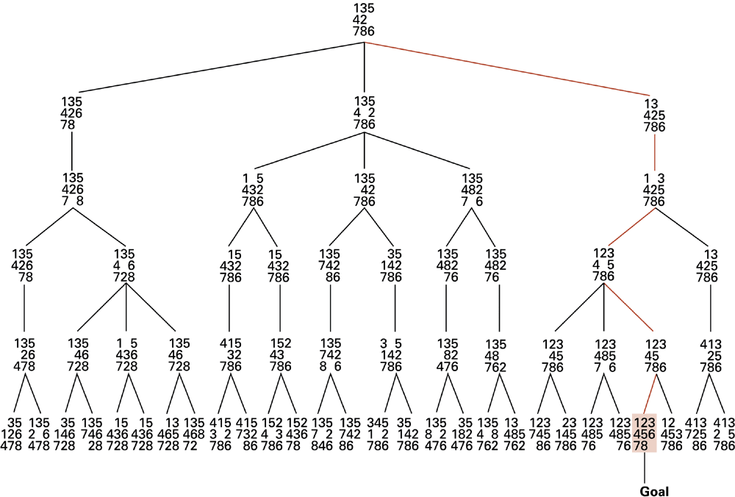
Figure 10.6 A sample search tree

Slide 16
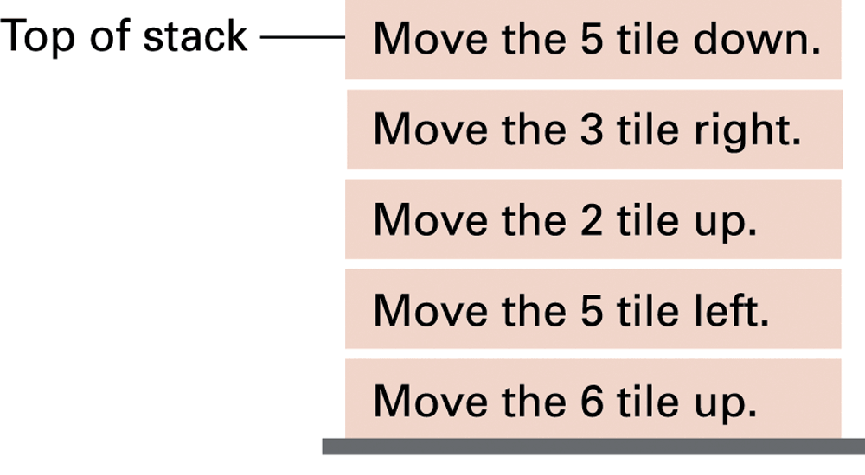
Figure 10.7 Productions stacked for later execution

Slide 17
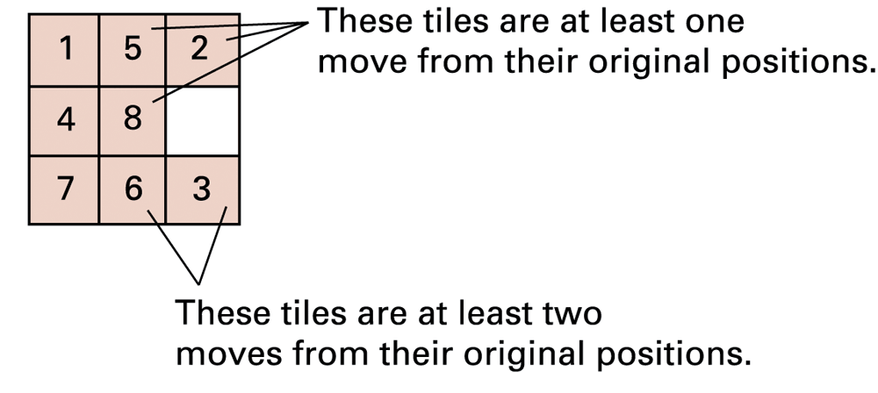
Figure 10.8 An unsolved eight-puzzle

Slide 18
Heuristic strategies
Requirements for good heuristics
  Must be much easier to compute than a complete solution
  Must provide a reasonable estimate of proximity to a goal

Slide 19
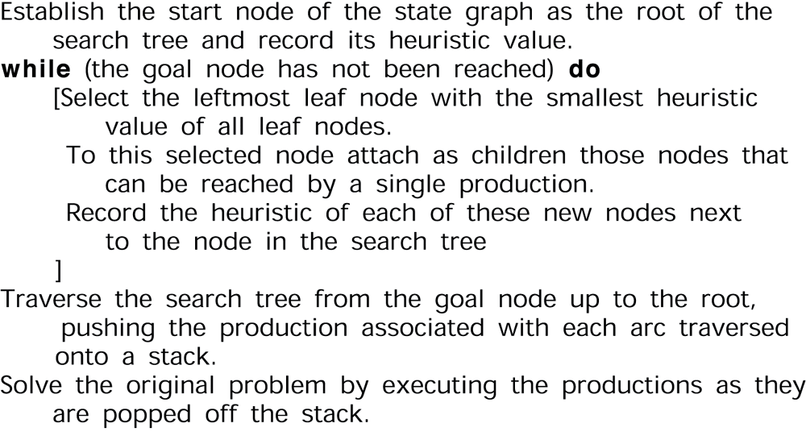
Figure 10.9 An algorithm for a control system using heuristics

Slide 20
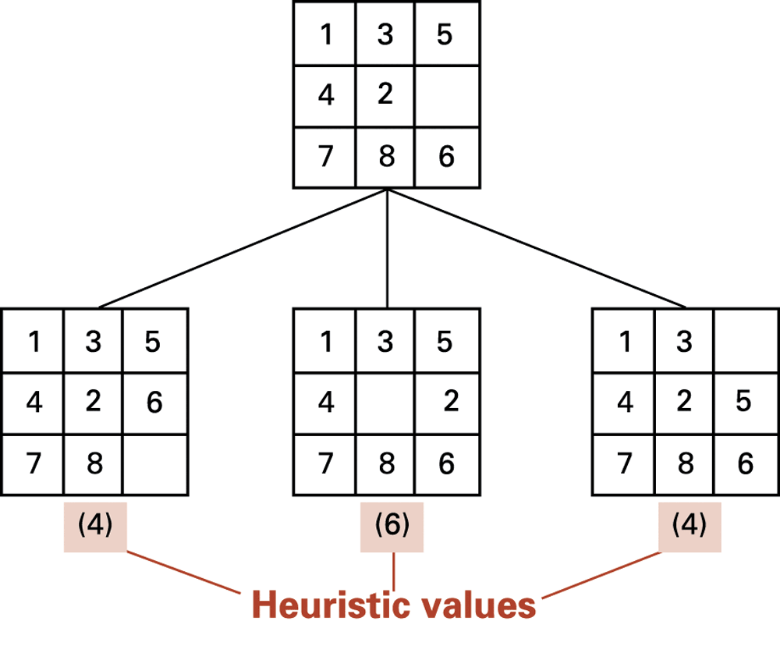
Figure 10.10 The beginnings of our heuristic search

Slide 21
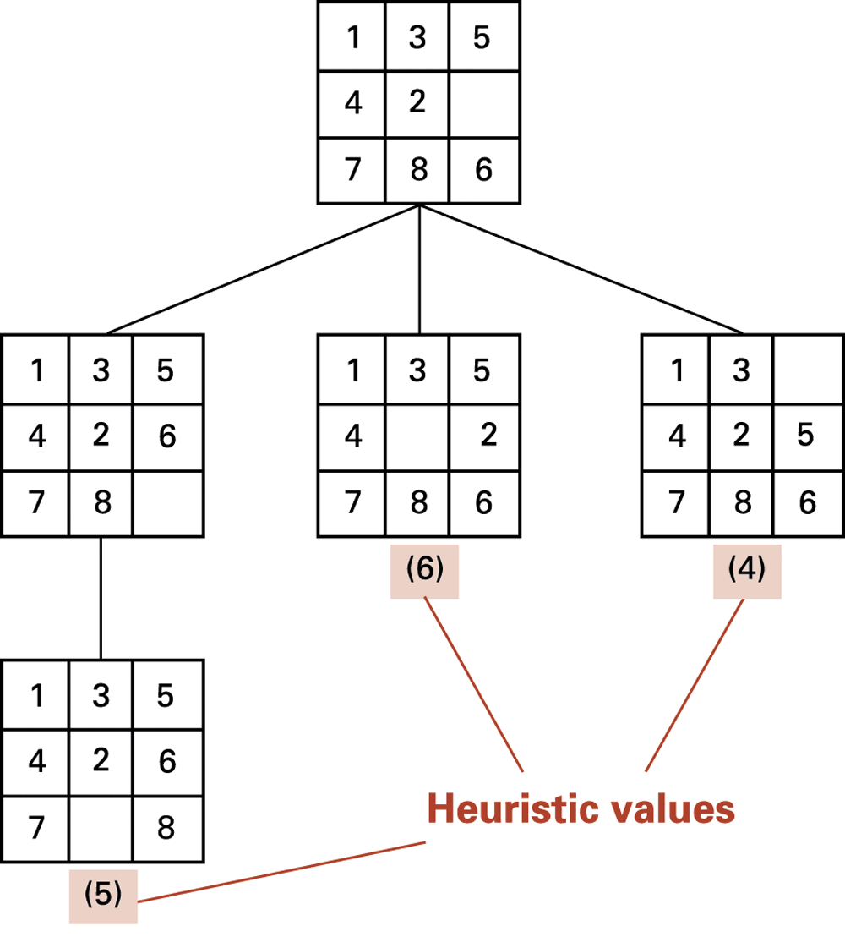
Figure 10.11 The search tree after two passes

Slide 22
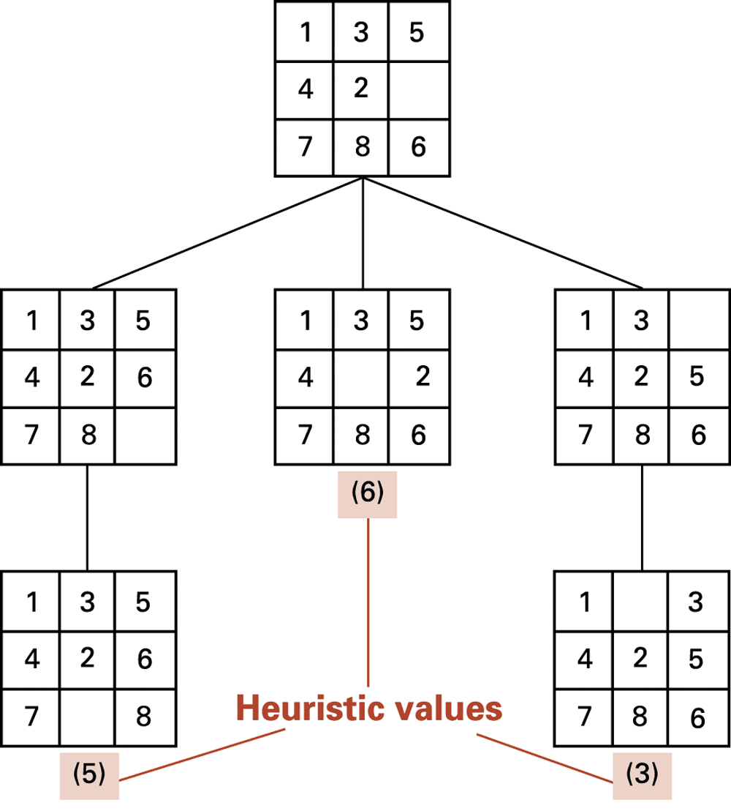
Figure 10.12 The search tree after three passes

Slide 23
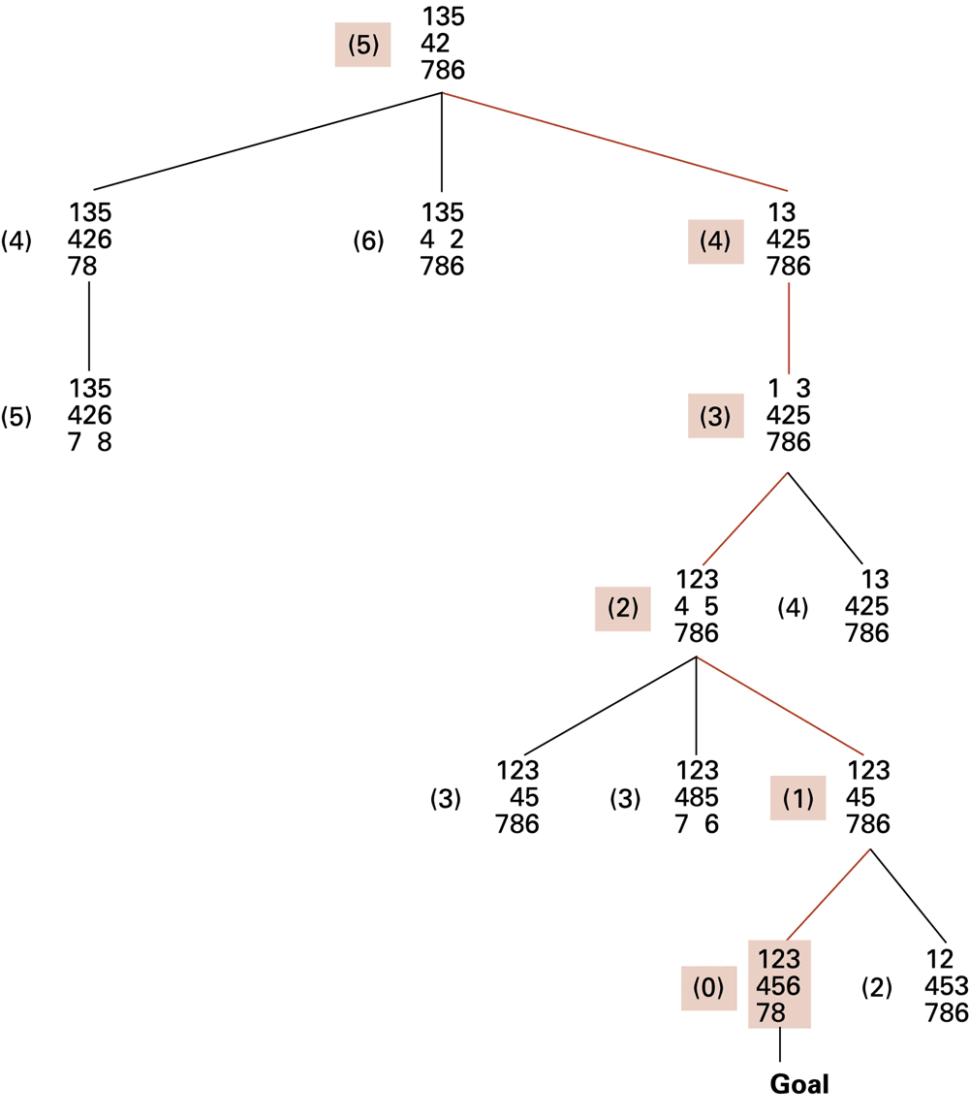
Figure 10.13 The complete search tree formed by our heuristic system

Slide 24
Neural networks
Artificial neuron
  Each input is multiplied by a weighting factor.
  Output is 1 if sum of weighted inputs exceeds a threshold value; 0 otherwise.
Network is programmed by adjusting weights using feedback from examples.

Slide 25
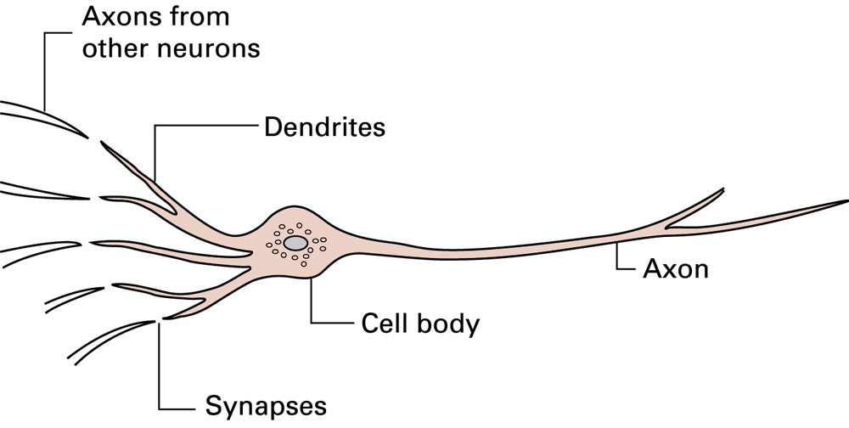
Figure 10.14 A neuron in a living biological system

Slide 26
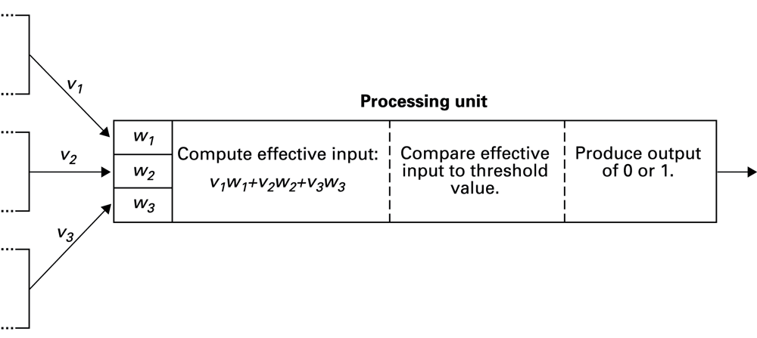
Figure 10.15 The activities within a processing unit

Slide 27
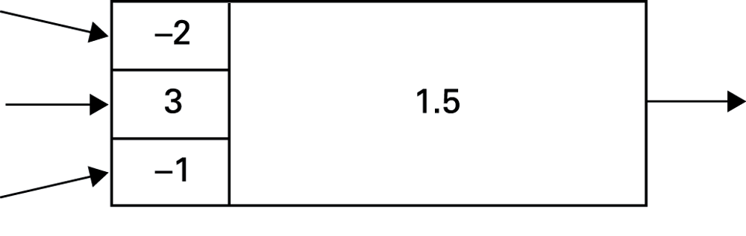
Figure 10.16 Representation of a processing unit

Slide 28
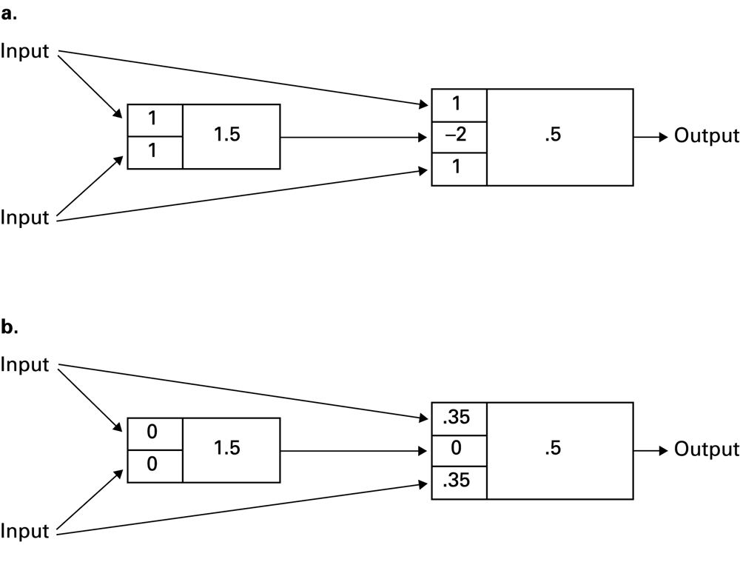
Figure 10.17 A neural network with two different programs

Slide 29
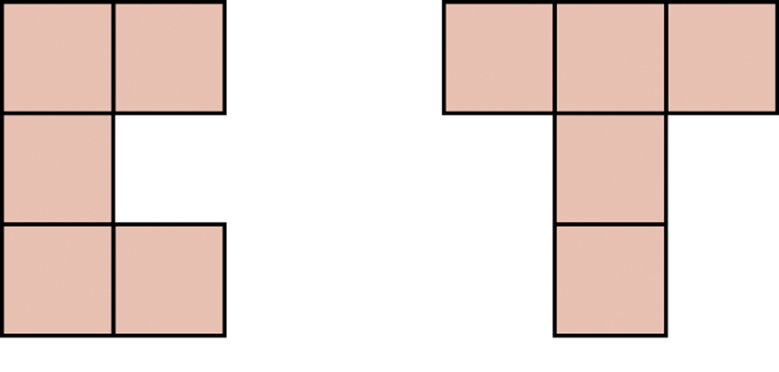
Figure 10.18 Uppercase C and uppercase T

Slide 30
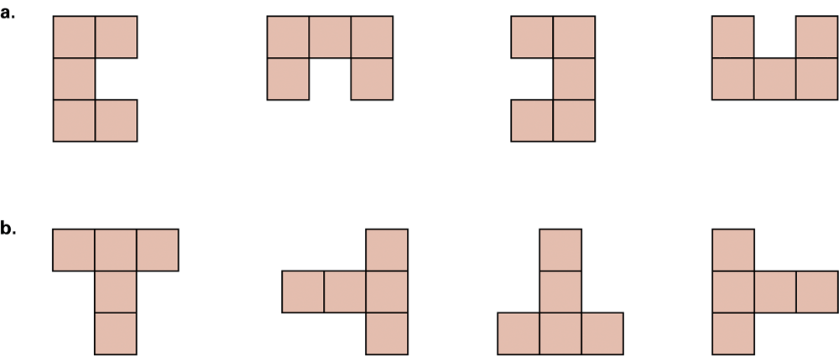
Figure 10.19 Various orientations of the letters C and T

Slide 31
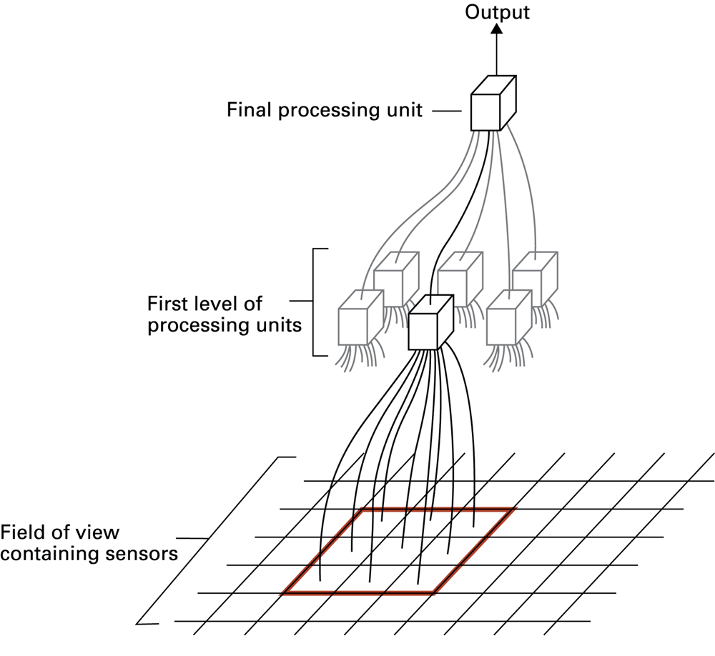
Figure 10.20 The structure of the character recognition system

Slide 32
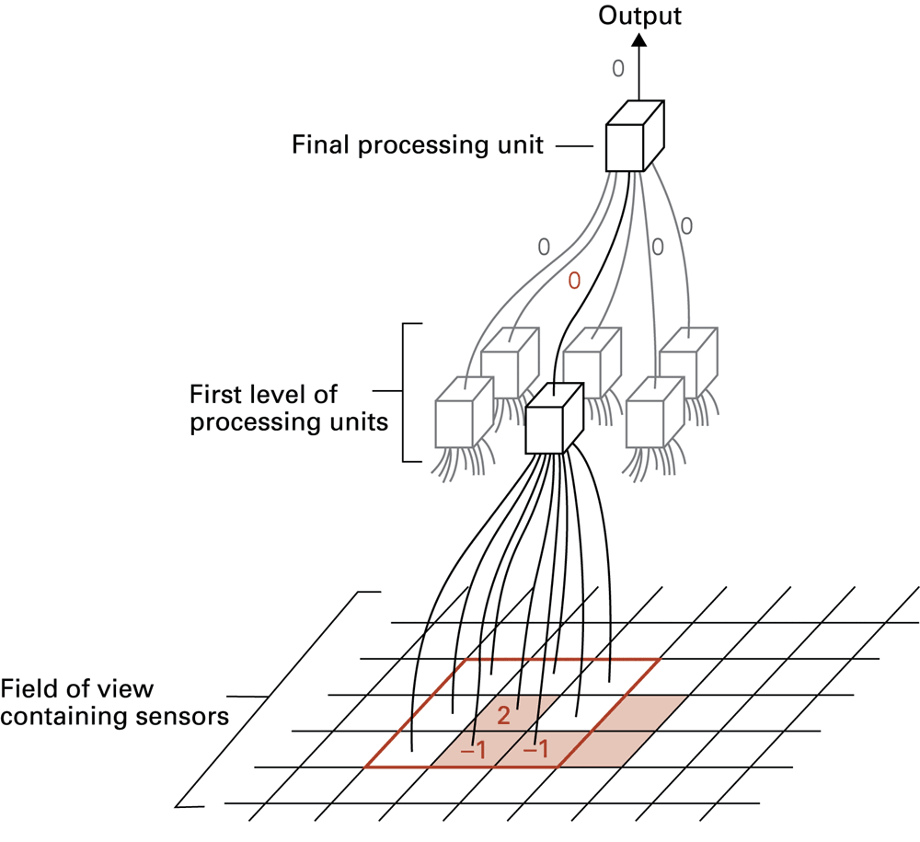
Figure 10.21 The letter C in the field of view

Slide 33
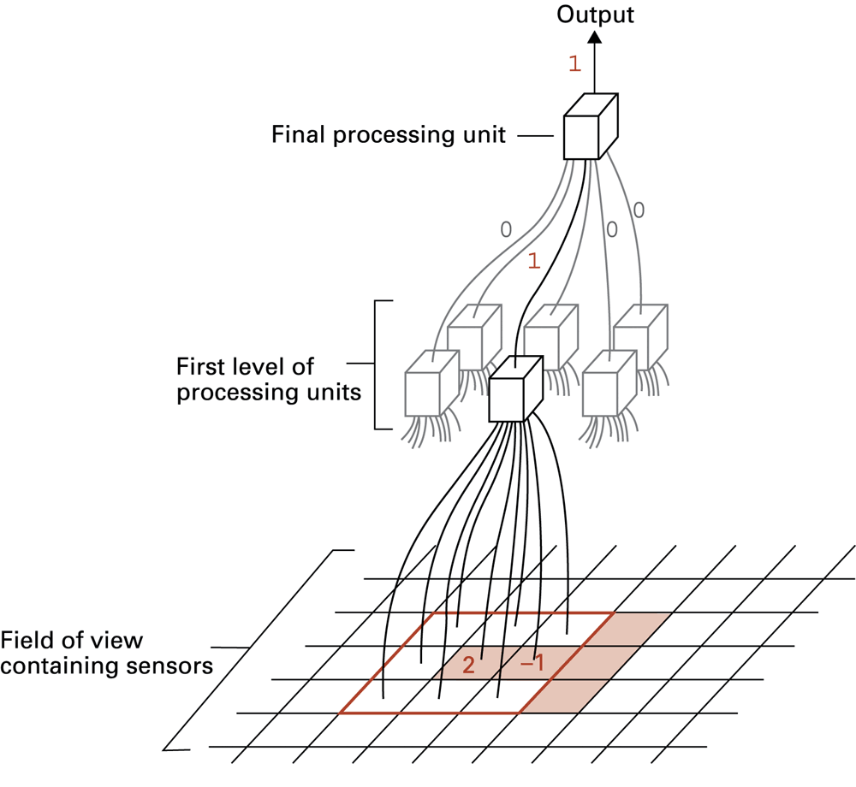
Figure 10.22 The letter T in the field of view

Slide 34
Associative memory
Associative memory = the retrieval of information relevant to the information at hand
One direction of research seeks to build associative memory using neural networks that when given a partial pattern, transition themselves to a completed pattern.

Slide 35
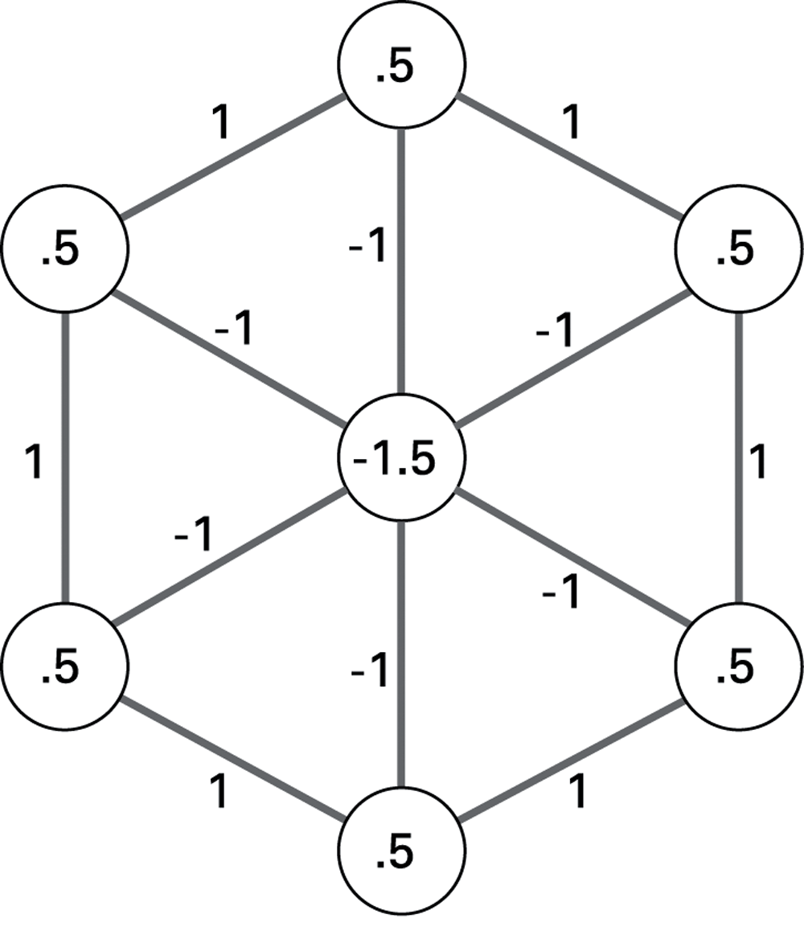
Figure 10.23 An artificial neural network implementing an associative memory

Slide 36
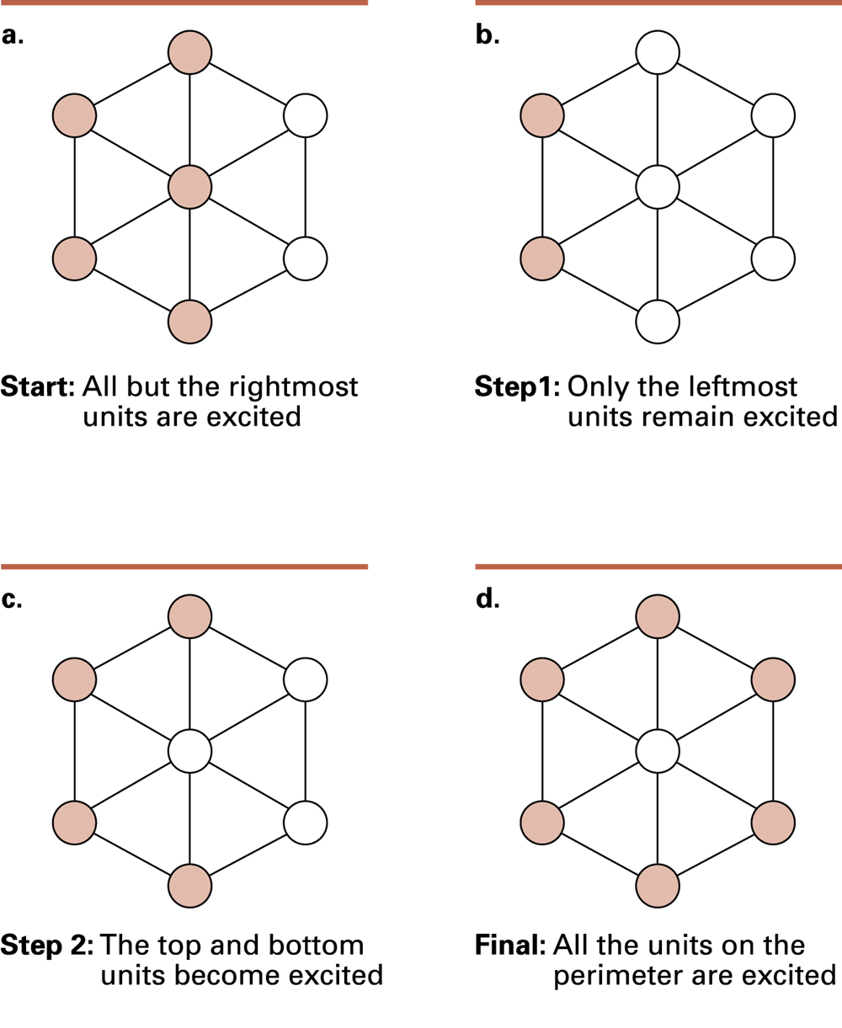
Figure 10.24 The steps leading to a stable configuration

Slide 37
Genetic algorithms
Simulate genetic processes to evolve algorithms
  Start with an initial population of “partial solutions.”
  Graft together parts of the best performers to form a new population.
  Periodically make slight modifications to some members of the current population.
  Repeat until a satisfactory solution is obtained.

Slide 38
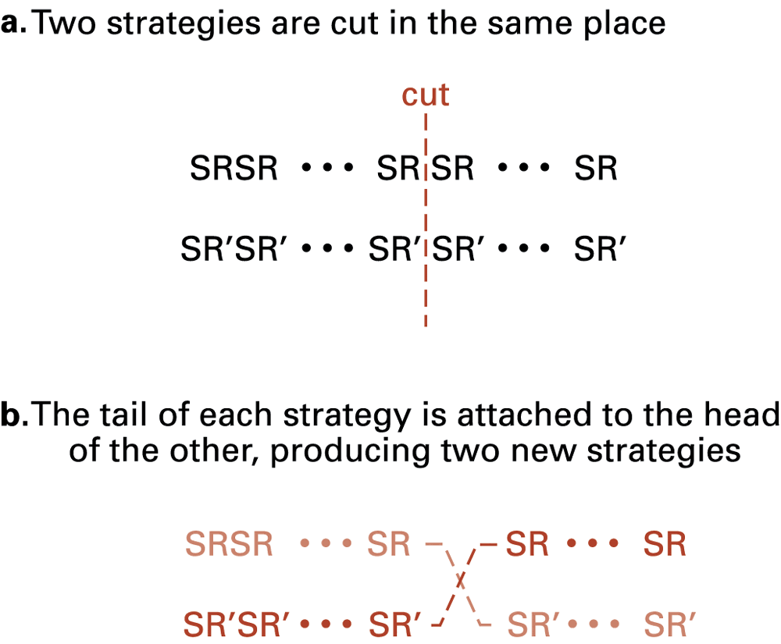
Figure 10.25 Crossing two poker-playing strategies

Slide 39
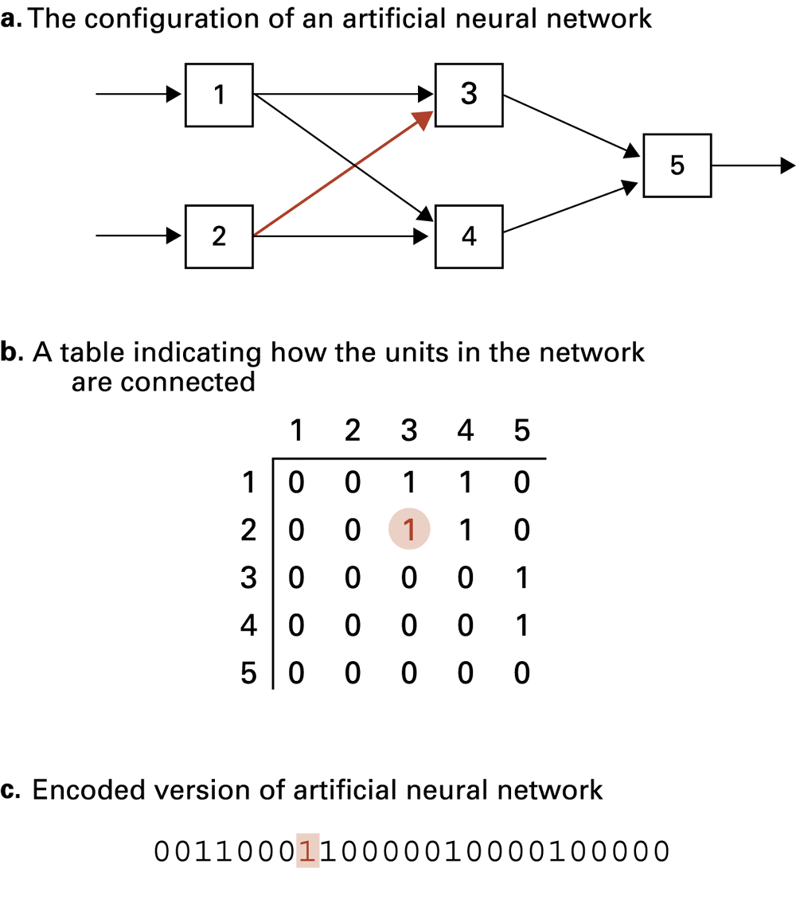
Figure 10.26 Coding the topology of an artificial neural network

Slide 40
Language processing
Syntactic analysis
Semantic analysis
Contextual analysis
Information retrieval
Information extraction
  Semantic net

Slide 41
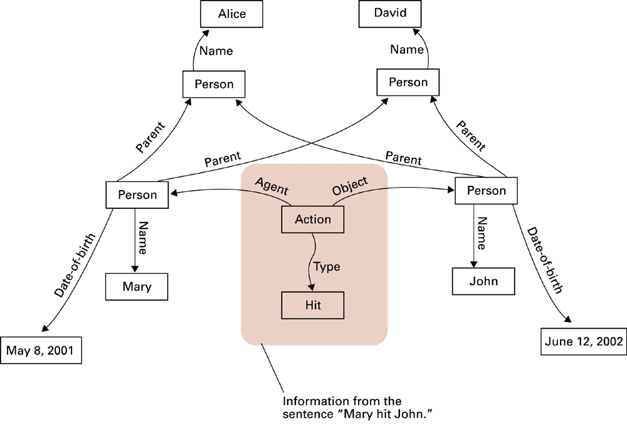
Figure 10.27 A semantic net

Slide 42
Robotics
Began as a field within mechanical and electrical engineering
Today encompasses a much wider range of activities
  Robocup competition
  Evolutionary robotics

Slide 43
Expert systems
Expert system = software package to assist humans in situations where expert knowledge is required
  Example: medical diagnosis
  Often similar to a production system
  Blackboard model: several problem-solving systems share a common data area

Slide 44
Some issues raised by artificial intelligence
When should a computer’s decision be trusted over a human’s?
If a computer can do a job better than a human, when should a human do the job anyway?
What would be the social impact if computer “intelligence” surpasses that of many humans?

